Slide 1

HR ANALYTICS : JOB CHANGE PREDICTION
Presented By
Group 4
Nidhi Chandramohan
Prithiviraj Maniram

Slide 2
Problem Statement
A company wants to hire employees to a Data Scientist position internally after conducting a training. Many employees’ signup for the same. They want to conduct a study to understand whether they will get return of investment they made for the training , i.e., the company want to find out whether the employees attending the training will remain in the company or will try to switch to new company as this training improved their skillset. Company also wants to find out what other factors influence an employee move.
Source : Kaggle

Slide 3
DATA SOURCES
Kaggle : https://www.kaggle.com/uniabhi/hr-analytics-job-change-of-data-scientists
License : CC0: Public Domain

Slide 4
HR Analytics : Job change prediction
Exploratory Data analysis
Pre-PROCESSING
Prediction
Source : Kaggle

Slide 5
Dataset/ Input/ Output
Input Variables
enrollee_id
city
city_development_index
Gender
relevant_experience
enrolled_university
education_level
major_discipline
experience ( In Months )
company_size
company_type
last_new_job
training_hours
Output Variable
JobChange ( Will change job or not ?)
Source : Kaggle

Slide 6
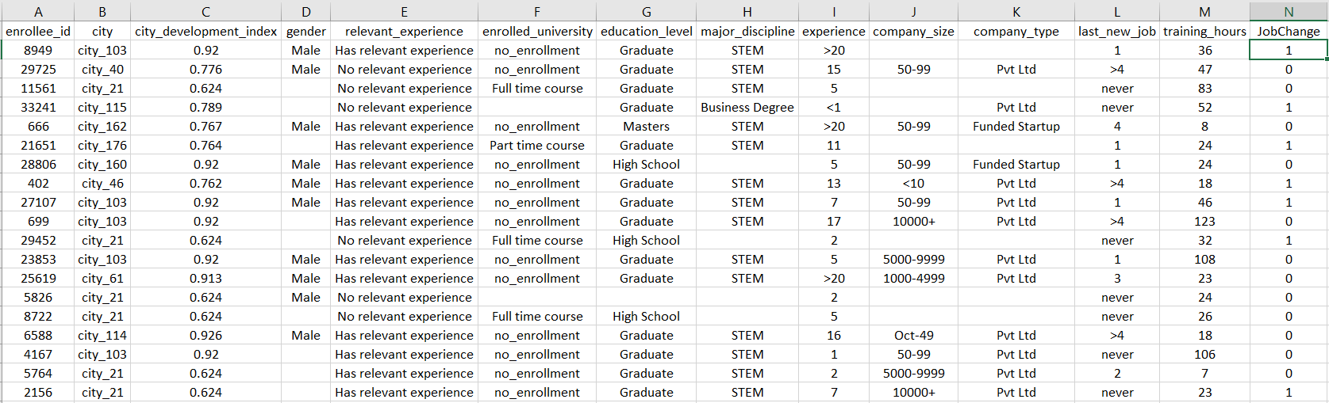
DATASET
Source : Kaggle

Slide 7

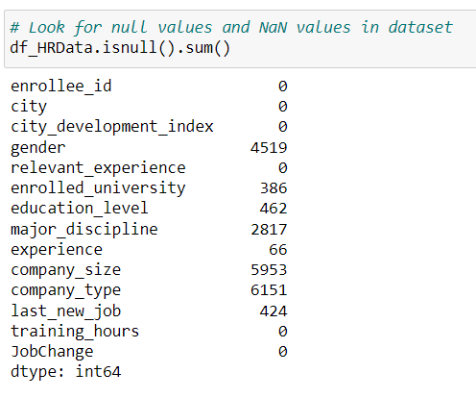
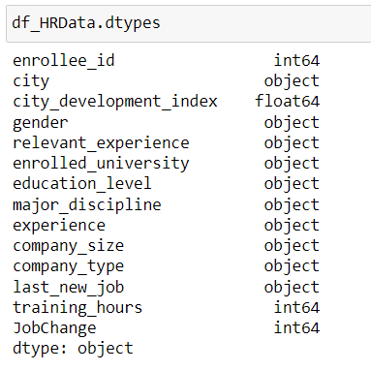
OBSERVATIONS / DATATYPES / NULL VALUES

Slide 8
DATA PREPARATION - 1
TRANSFORMED DATA IN BELOW COLUMNS
discipline
experience
company_size
last_new_job
FILLED “NA” VALUES WITH “NO ANSWER”
gender
relevant_experience
enrolled_university
education_level
major_discipline
company_type

Slide 9
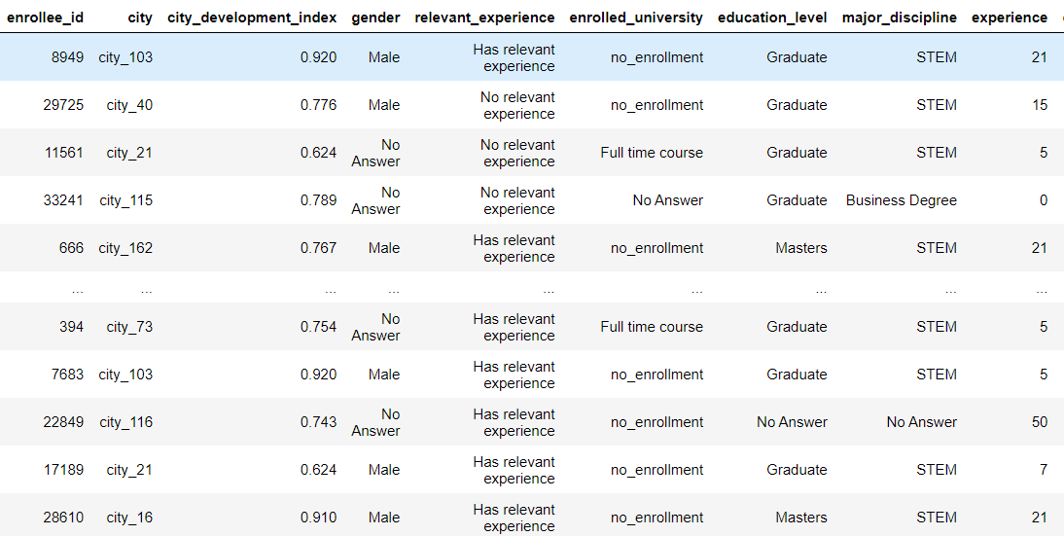
DATA AFTER TRANSFORMATION

Slide 10
DATA PREPARATION - 2
TRANSFORMED DATA IN BELOW COLUMNS
discipline experience
company_size
last_new_job
Dropped all Null values
Rows Before Dropping NA values | Rows After Dropping NA values
19193 | 8966

Slide 11

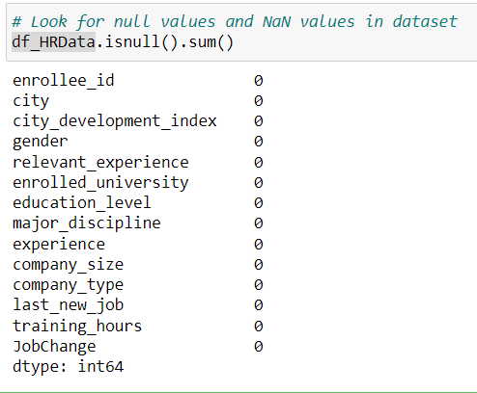
DATA AFTER DROPPING NULL VALUES

Slide 12
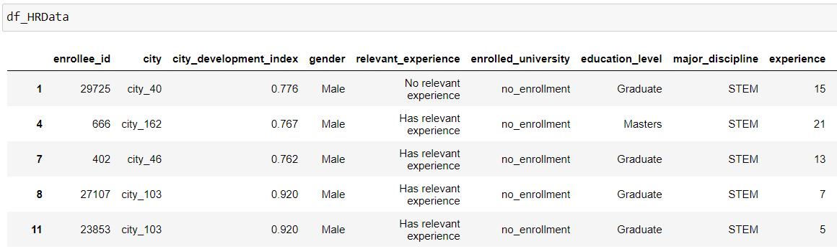
DATASET AFTER DROPPING NULL VALUES

Slide 13
EXPLORATORY DATA ANALYSIS

Slide 14
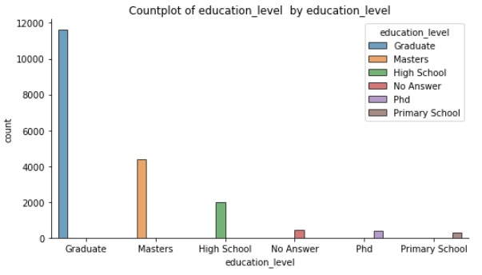
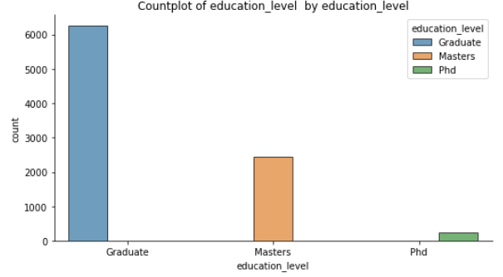
COUNT PLOT OF EDUCATION LEVEL
Without Dropping Null Values
After Dropping Null Values

Slide 15
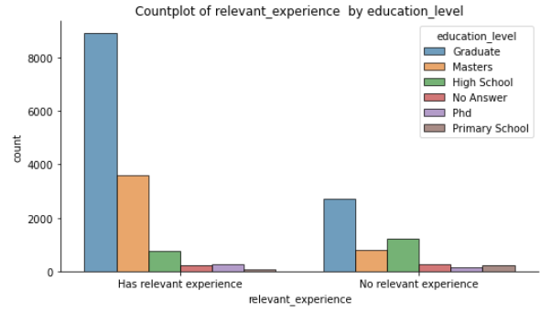
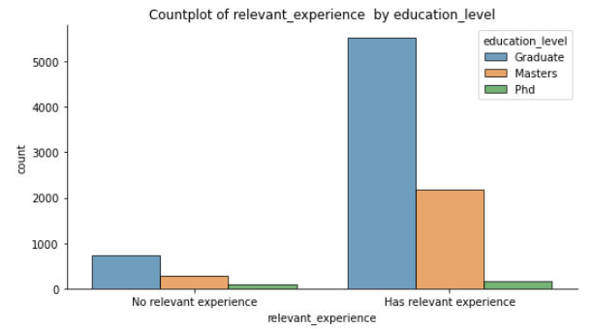
Relevant experience vs Education Level
Without Dropping Null Values
After Dropping Null Values

Slide 16
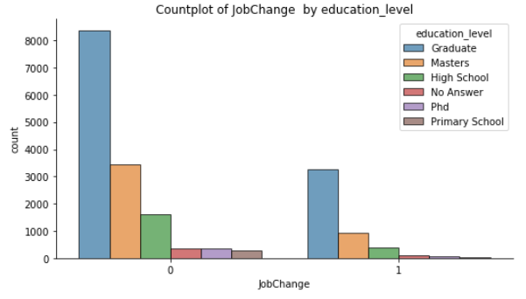
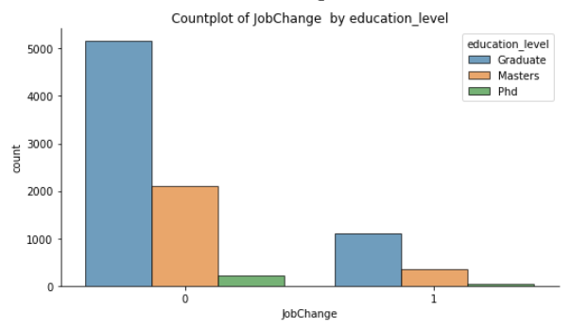
Job Change vs Education Level
Without Dropping Null Values
After Dropping Null Values

Slide 17
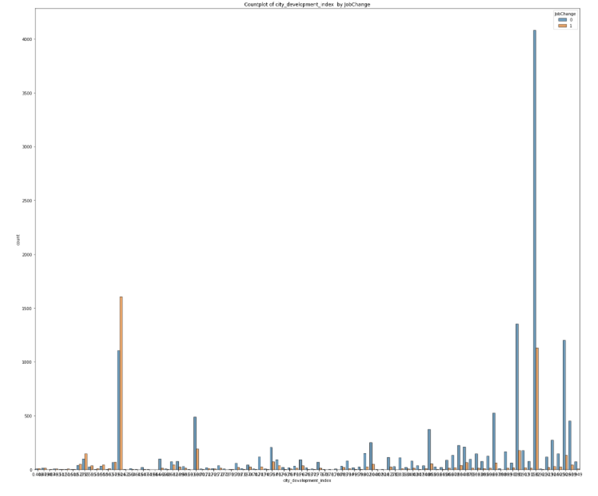
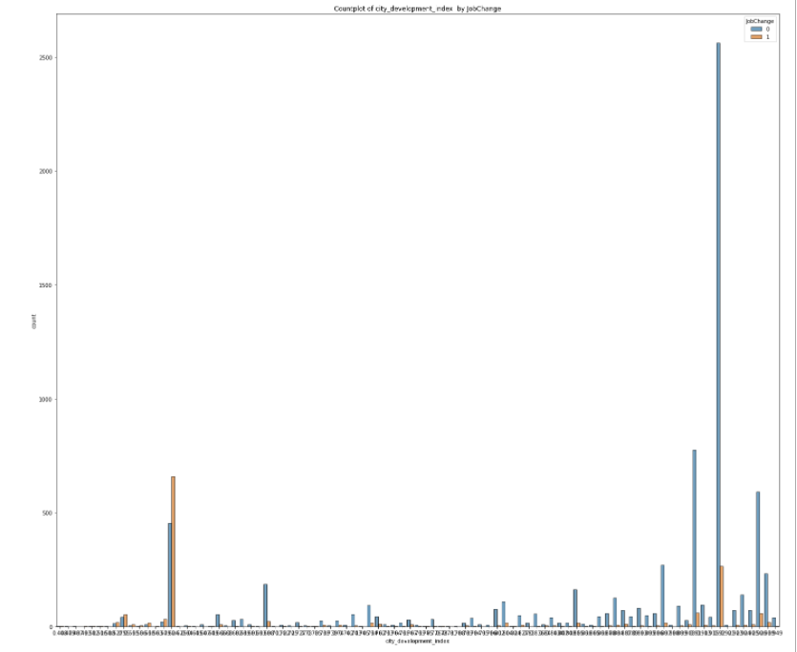
Count Plot By Job Change vs City_Development_Index
Without Dropping Null Values
After Dropping Null Values

Slide 18
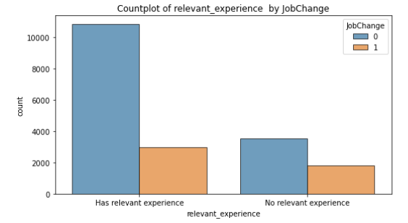
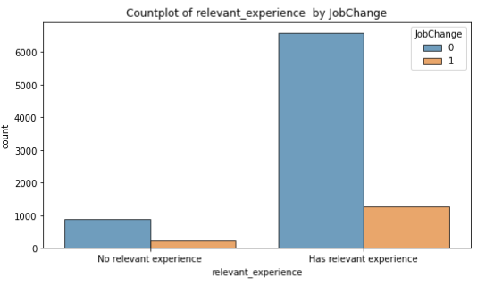
Count Plot By Job Change vs relevant_experience

Slide 19
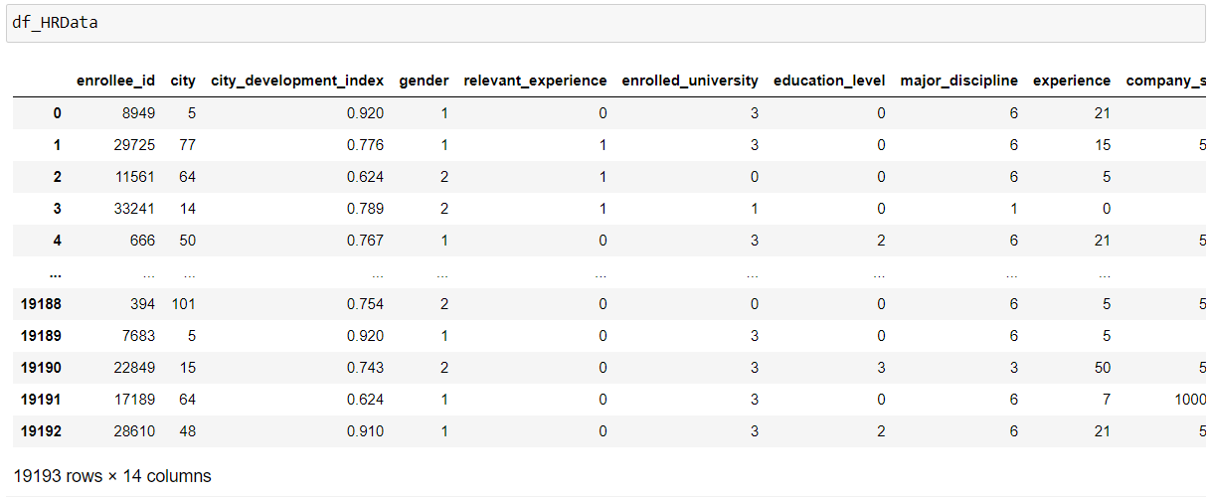
DATA ENCODING
LABEL ENCODER

Slide 20
SPLIT
Using “train_test_split”
Training data – 60 %
Test Data – 40 %

Slide 21
DATA MODELING
LOGISTIC REGRESSION
RANDOM FOREST
KNN
NAÏVE BAYES

Slide 22
LOGISTIC REGRESSION
Without Dropping Null Values
After Dropping Null Values
Accuracy | 75 %
Accuracy | 83.9 %
0 – Will not change job 1- Will change job | Predicted 0 | Predicted 1
Actual 0 | 5657 | 108
Actual 1 | 1808 | 105
0 – Will not change job 1- Will change job | Predicted 0 | Predicted 1
Actual 0 | 3009 | 2
Actual 1 | 573 | 3

Slide 23
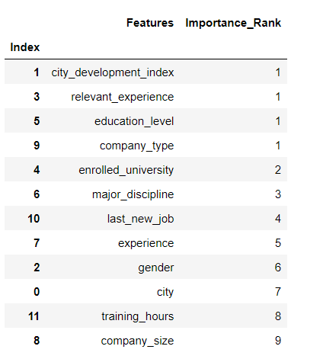
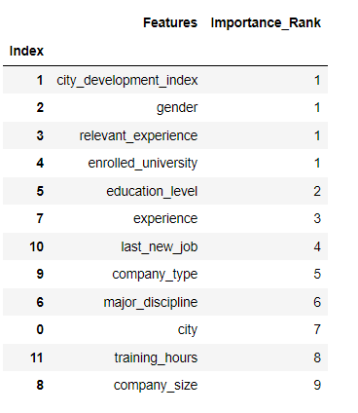
Logistic Regression- Variable Importance
Without Dropping Null Values
After Dropping Null Values

Slide 24
RANDOM FOREST
Without Dropping Null Values
After Dropping Null Values
Accuracy | 78 %
Accuracy | 85.6 %
0 – Will not change job 1- Will change job | Predicted 0 | Predicted 1
Actual 0 | 5123 | 642
Actual 1 | 1021 | 892
0 – Will not change job 1- Will change job | Predicted 0 | Predicted 1
Actual 0 | 2857 | 154
Actual 1 | 360 | 216

Slide 25
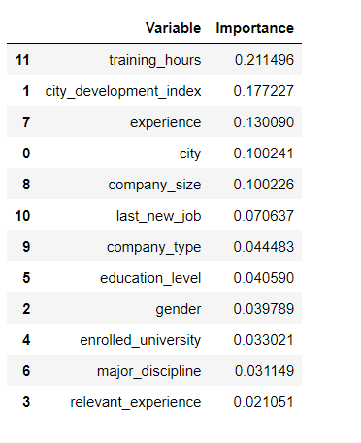
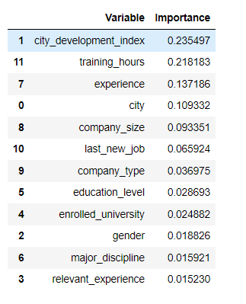
RANDOM FOREST VARIABLE IMPORTANCE
Without Dropping Null Values
After Dropping Null Values

Slide 26
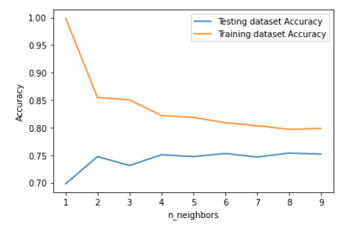
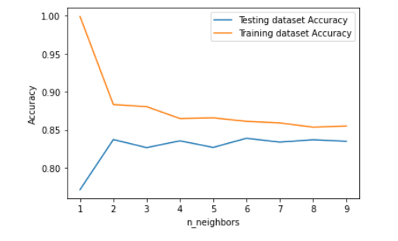
KNN
Without Dropping Null Values
After Dropping Null Values
AccuracyK = 3 | 73 %
AccuracyK = 3 | 82 %
FINDING OPTIMAL K
FINDING OPTIMAL K

Slide 27
KNN
Without Dropping Null Values
After Dropping Null Values
AccuracyK = 8 | 75 %
Accuracy K = 8 | 84 %
0 – Will not change job 1- Will change job | Predicted 0 | Predicted 1
Actual 0 | 4862 | 903
Actual 1 | 1162 | 751
0 – Will not change job 1- Will change job | Predicted 0 | Predicted 1
Actual 0 | 2907 | 104
Actual 1 | 481 | 95

Slide 28
NAÏVE BAYES
Without Dropping Null Values
After Dropping Null Values
Accuracy | 76 %
Accuracy | 84.7%
0 – Will not change job 1- Will change job | Predicted 0 | Predicted 1
Actual 0 | 5254 | 511
Actual 1 | 1328 | 585
0 – Will not change job 1- Will change job | Predicted 0 | Predicted 1
Actual 0 | 2960 | 51
Actual 1 | 495 | 81

Slide 29
COMPARING MODELS
TECHNIQUES APPLIED | Model | ACCURACY | F1-Score | PRECISION | RECALL
LOGISTIC REGRESSION | Without Dropping NULL | 75% | 86% | 76% | 98%
 | After Dropping NULL | 84% | 91% | 84% | 100%
RANDOM FOREST | Without Dropping NULL | 78% | 86% | 83% | 88%
 | After Dropping NULL | 86% | 92% | 89% | 95%
KNN | Without Dropping NULL | 75% | 84% | 76% | 95%
 | After Dropping NULL | 84% | 91% | 84% | 99%
NAÏVE BAYES | Without Dropping NULL | 76% | 85% | 80% | 91%
 | After Dropping NULL | 85% | 86% | 92% | 98%

Slide 30
COMPARISON OF MODELS

Slide 31
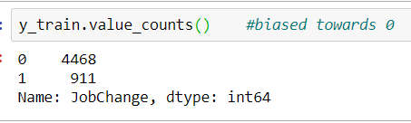
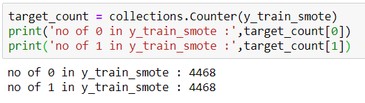
SMOTE- Synthetic Minority Oversampling TEchnique
Applied SMOTE to remove Biasedness in the target dataset
1’s have been oversampled
Before Applying SMOTE:
After Applying SMOTE:

Slide 32
RANDOM FOREST
Before SMOTE
After SMOTE
Accuracy | 85%
Accuracy | 85.3 %
0 – Will not change job 1- Will change job | Predicted 0 | Predicted 1
Actual 0 | 2870 | 141
Actual 1 | 401 | 175
0 – Will not change job 1- Will change job | Predicted 0 | Predicted 1
Actual 0 | 2813 | 198
Actual 1 | 343 | 233

Slide 33
RECOMMENDATIONS
FACTORS INFLUENCING JOB CHANGE
In Majority of the models we created city development index was having high importance
In cities with low development index, higher percent of employees tend to switch their job
DEVELOPED A MODEL TO PREDICT JOB CHANGE AMONG EMPLOYEES TAKING INTERNAL TRAINING

Slide 34
Learning Outcomes
select a better dataset which is not so much preprocessed
Better Insights ( eg: city doesn’t have names
Various approaches towards pre-processing of data in terms of handling Null values
Executed Filling techniques
Replacement of NaN with new categorical values
Dropping of NaN values
Better visualization of the trends between different features through extensive Exploratory Data Analysis through plots
Implementation of multiple machine learning algorithms
Elimination of Biasedness by implementing SMOTE

Slide 35
Future Work
We intend to continue working on this kind of project ,possibly with a less pre-processed dataset
Implement other Machine Learning algorithms such as Artificial Neural Network and XGBoost

Slide 36
QUESTIONS ??

